Slide 1









SESHAA
Staffordshire Emergency Services Humanitarian Aid Association
Registered Charity Number 1070739

Slide 2

Mission Statement SESHAA
SESHAA is dedicated to provide Emergency services in areas of natural disaster, war-torn and developing Countries with the training and resources to save lives, we also raise awareness of the plight of the Emergency Service Personnel we help and further assist in serving the world’s impoverished with humanitarian Aid and assistance, regardless of politics, race, religion or Gender.

Slide 3
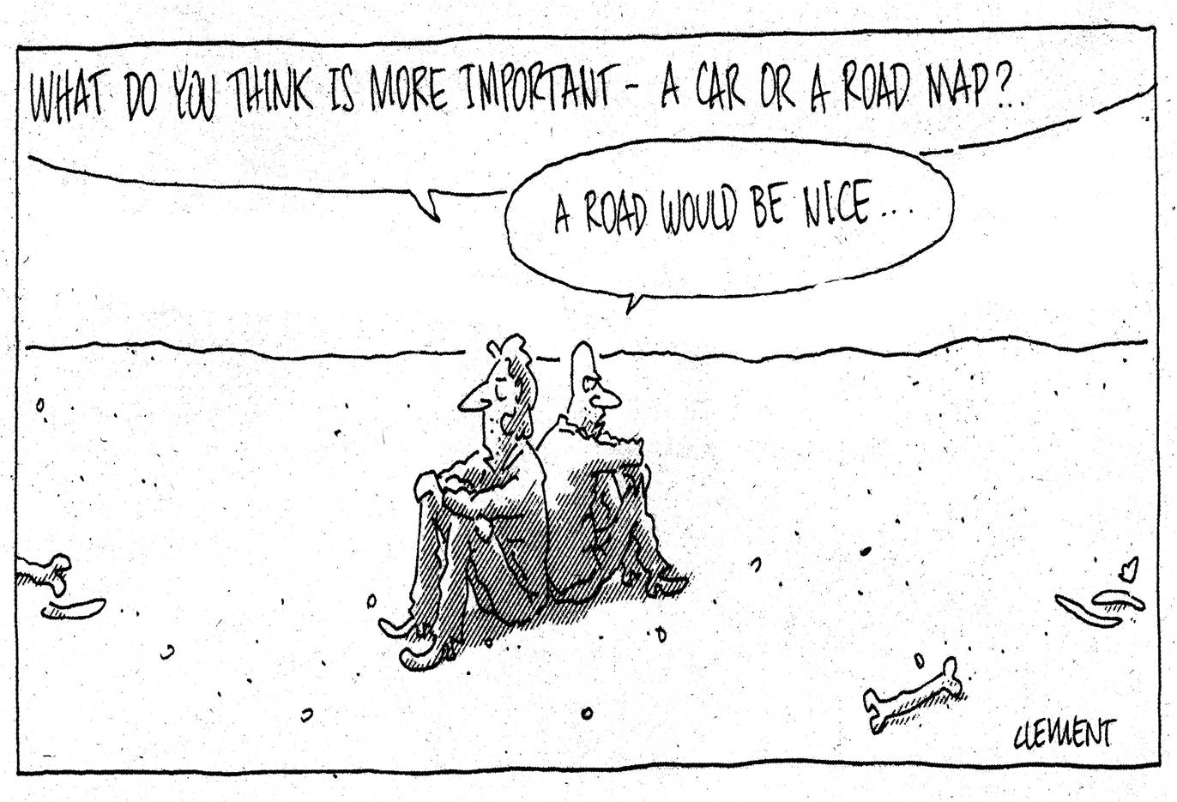
Sustainability

Slide 4
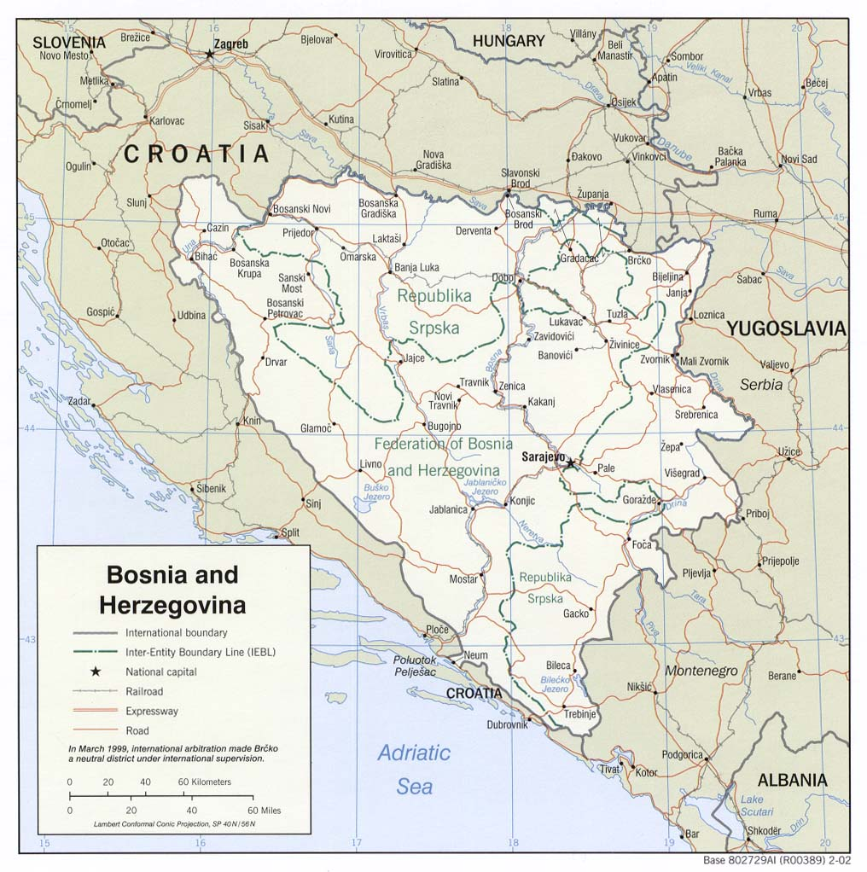
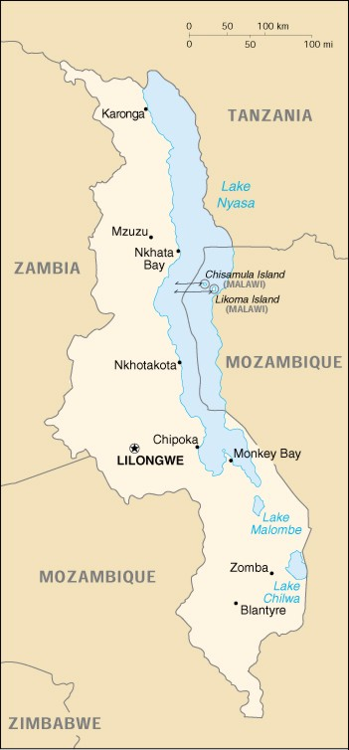
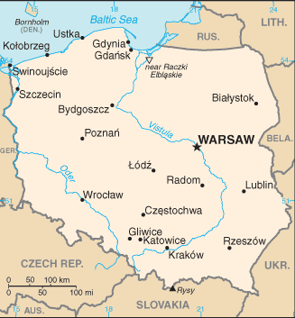
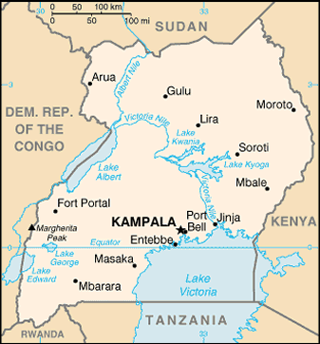
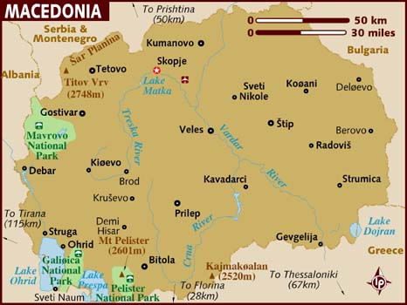
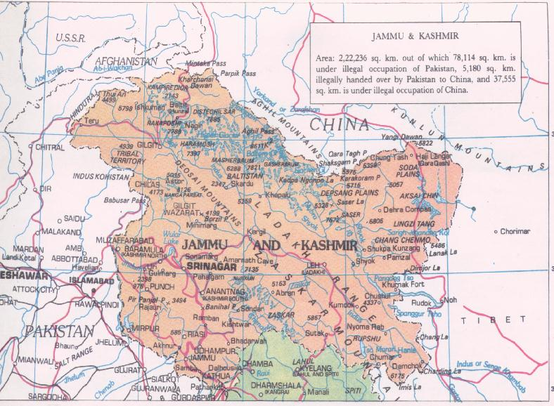
1995 to 2011
1995 to 1999
1999 to 2002
2005 to 2007
2008
2009 to 2010
2011

Slide 5


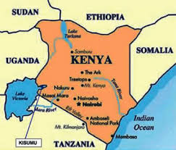
2012 to 2020
2012
2013
2014
2012 Westminster Tajikistan 2015 to present

Slide 6
FIREAID member projects around the world.

Slide 7

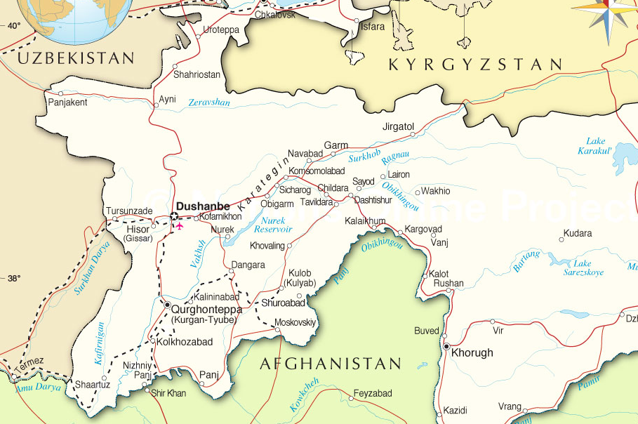
Dushanbe, Tajikistan Project Areas.
2015
to present

Slide 8

SESHAA Convoy 5,010 miles from Stafford, UK to Dushanbe, Tajikistan.
2017

Slide 9

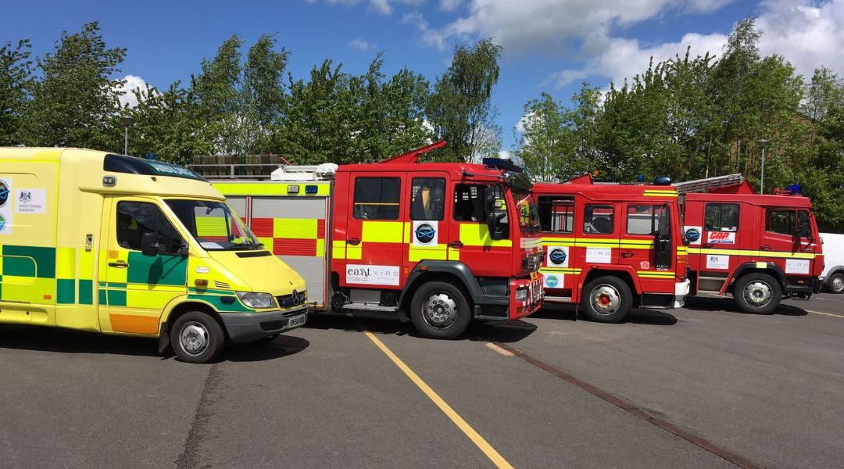
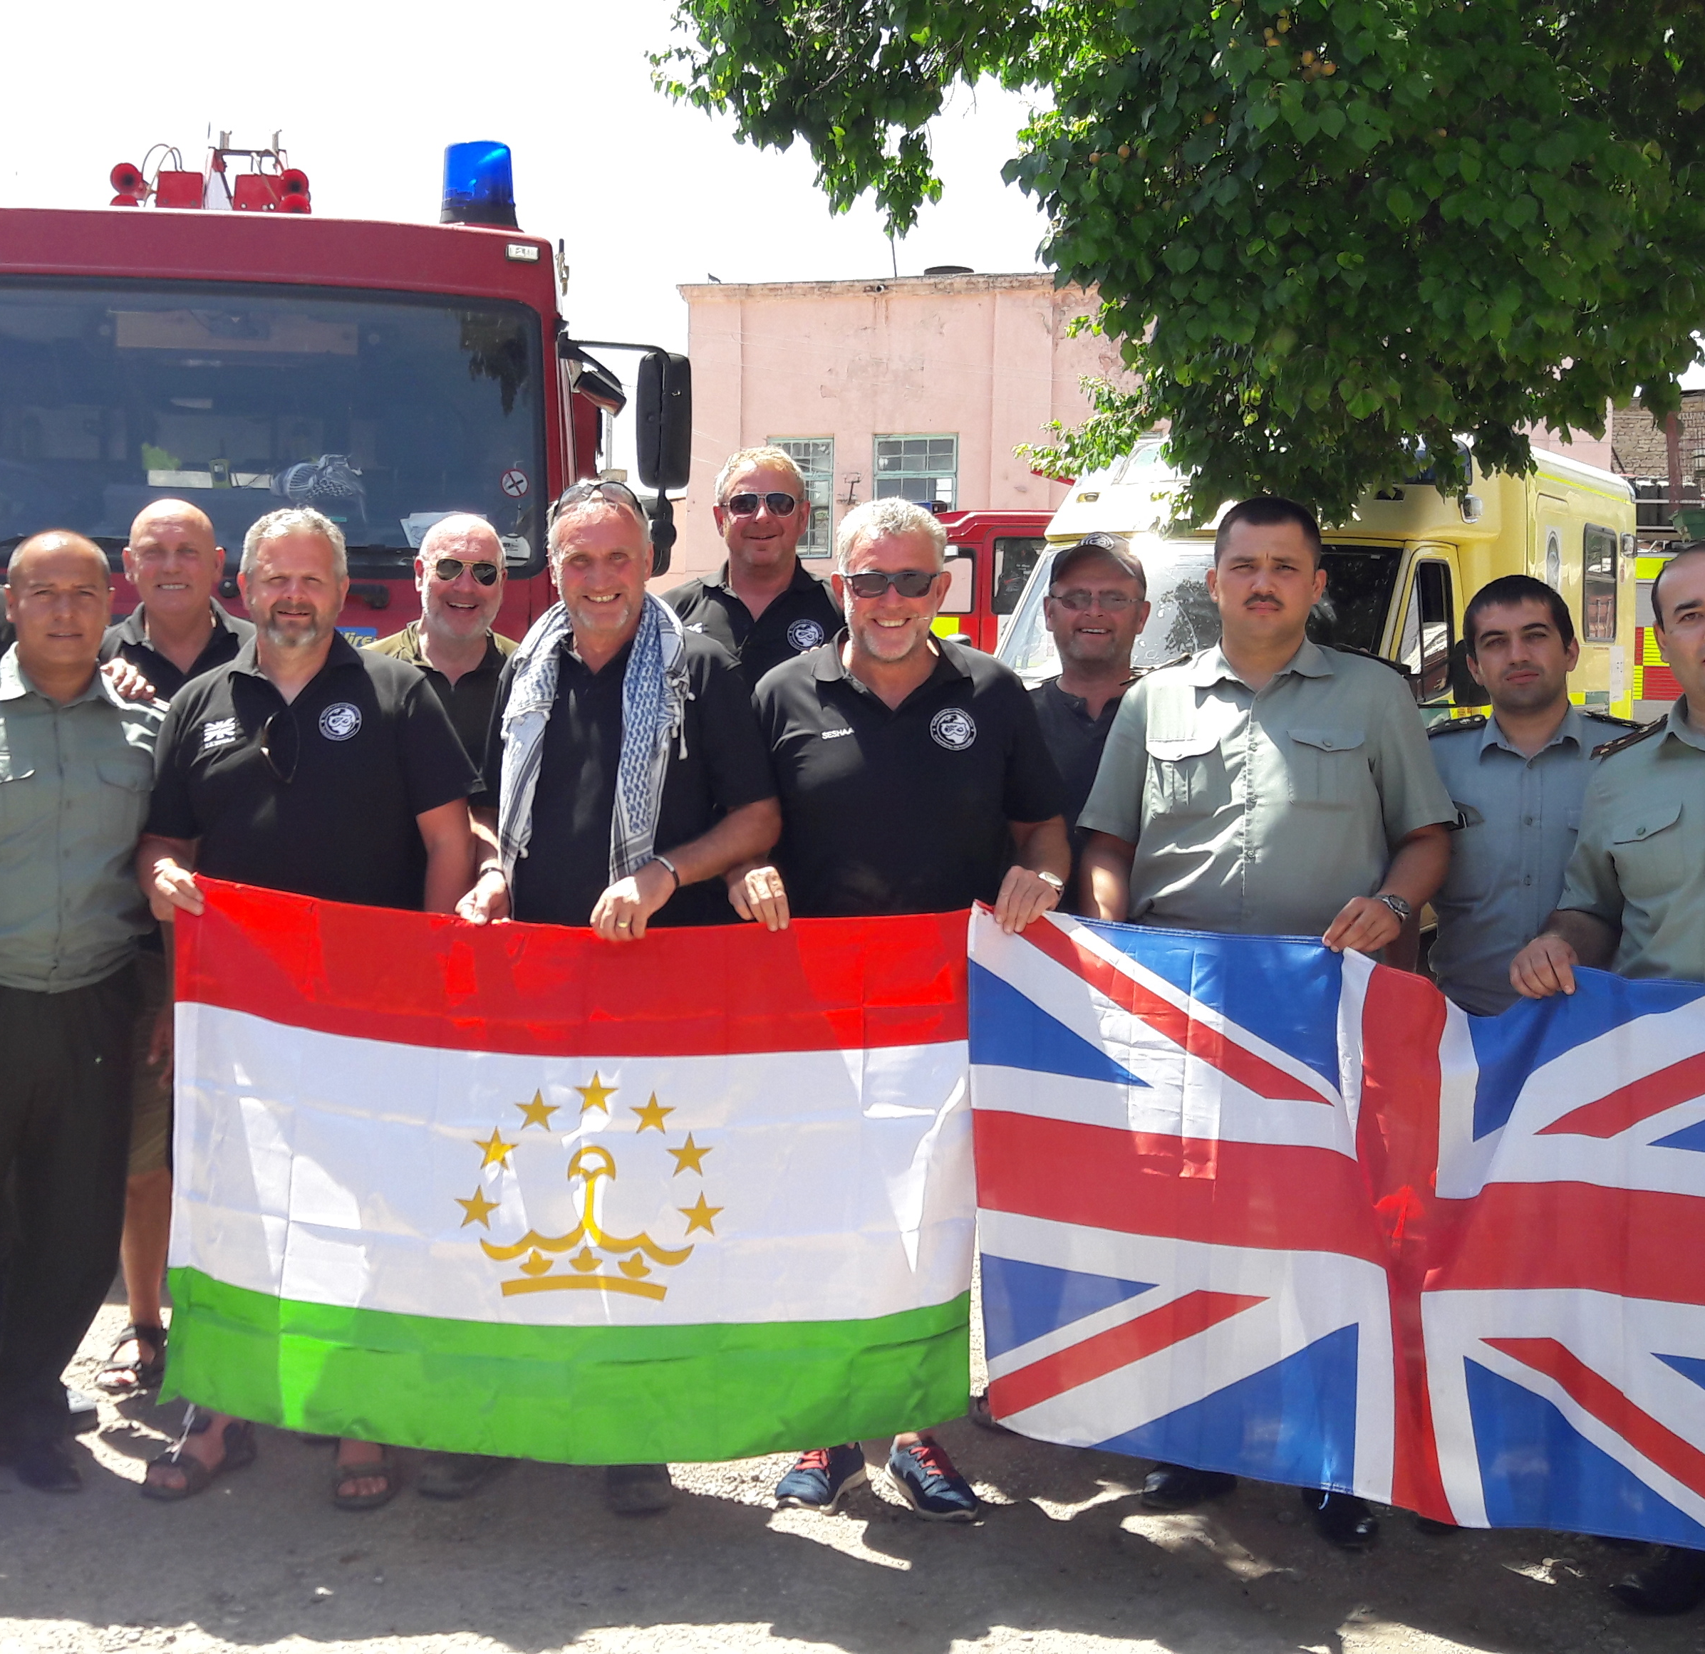
Tajikistan Convoy 2017

Slide 10
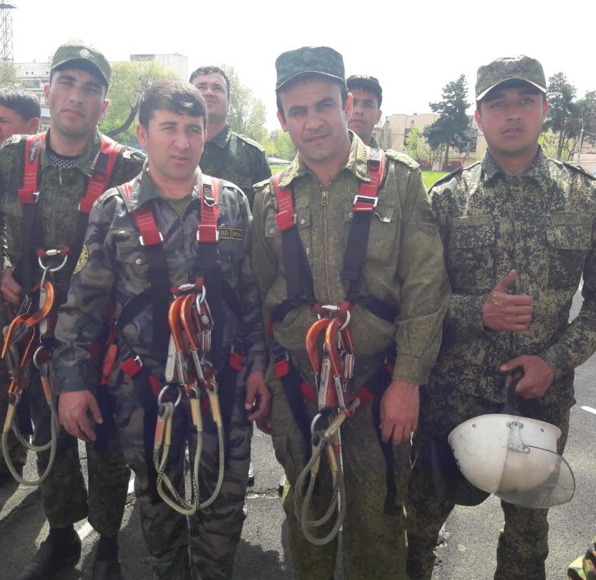
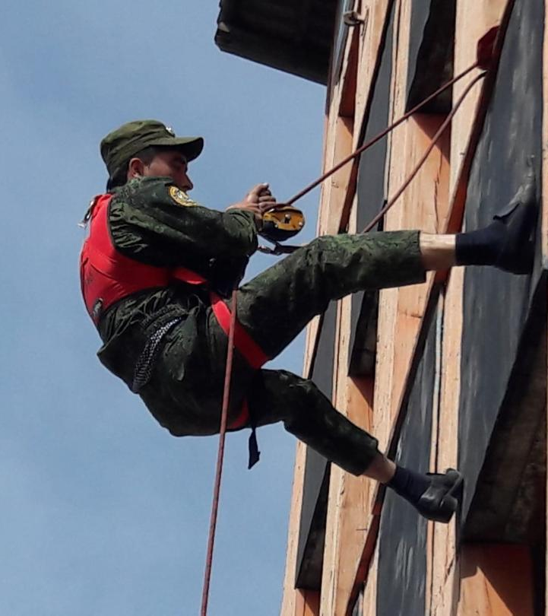
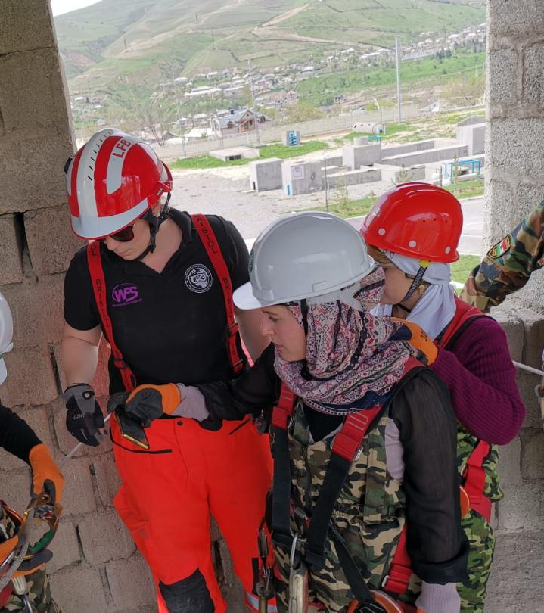
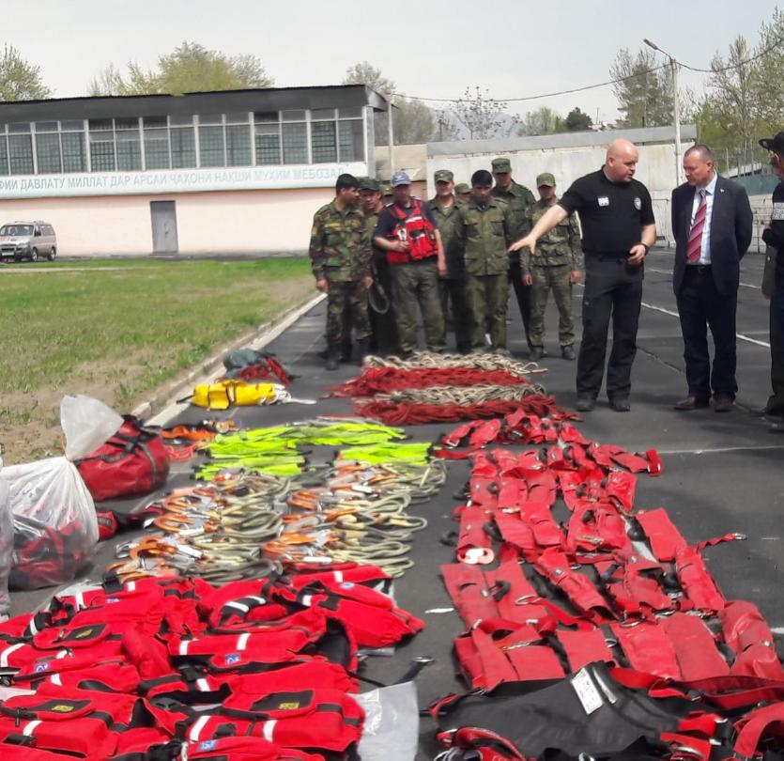
Line Rescue Dushanbe 2019

Slide 11

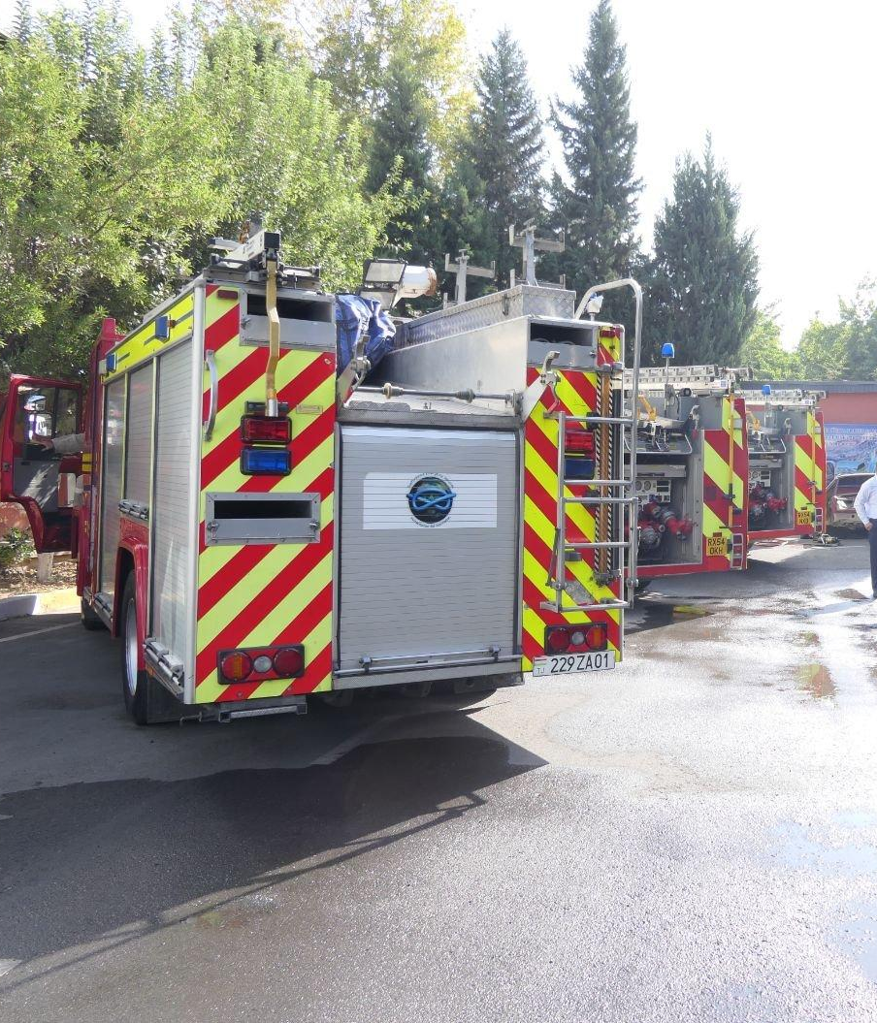
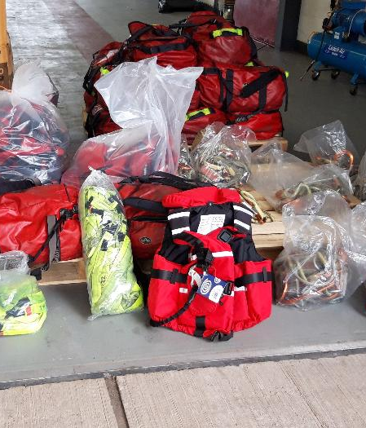
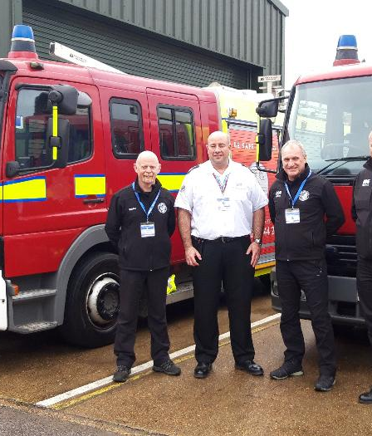
Tajikistan Convoy 2019

Slide 12
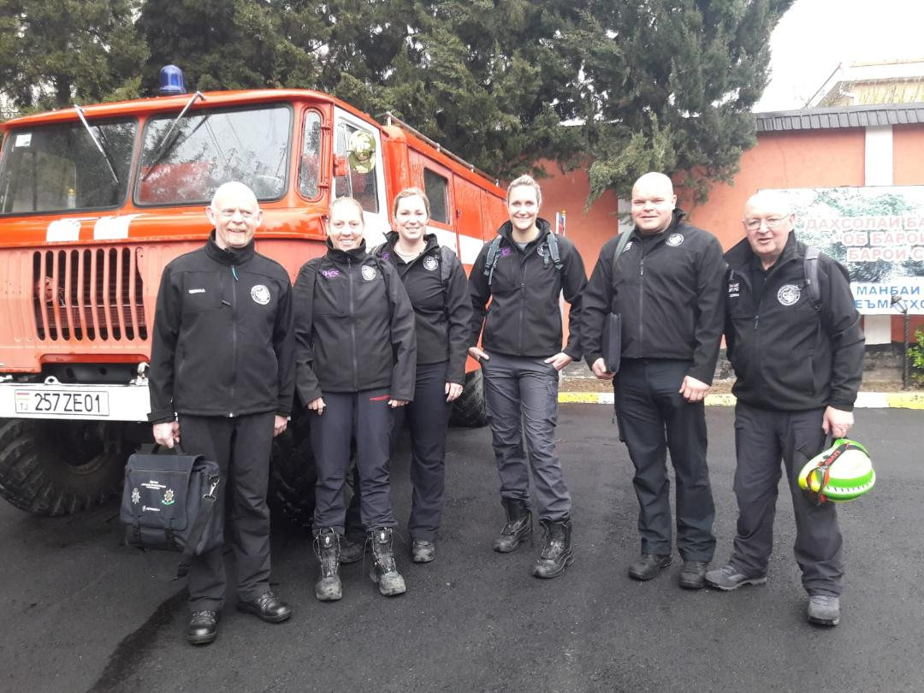



Slide 13



Thank you for listening
Any Questions?

