Slide 1
Staffordshire Fire and Rescue Service
Community Risk Management Plan
CRMP 2025 - 2028
Consultation Summary

Slide 2
Contents
Introduction
Aims
Survey Results
Survey Summary Numbers
Completed Surveys by Postcode Area
Community representation
Awareness of and Use of Services
Staffordshire Fire and Rescue Service should do more to…
Levels of confidence to keep safe
Three firefighters crewing On-call fire engines
Home from Hospital/Falls Response
Intelligent Monitoring of Fire Engine Availability

Slide 3
Introduction
As part of our duty to consult the public, staff, and other stakeholders on the CRMP, the service adopted a comprehensive approach to gather feedback. This included conducting both internal and external surveys to capture a wide range of perspectives.
In addition, Social & Market Strategic Research (SMSR) were commissioned to conduct public perception focus groups to provide qualitative insights, and offering a platform for participants to share detailed opinions and experiences. These groups ensured we captured diverse viewpoints and explored the reasons behind public perceptions. The results of which are provided in a separate document, but where linked and appropriate, are referenced in support or in challenge to the survey results.
Together, these efforts have allowed the service to assess community awareness, engagement with our services, and support for new initiatives, while identifying opportunities to shape the CRMP to better meet the needs of our People, our Communities, and our Environment.

Slide 4
Aims
  Understand how well our services are known and used across different groups.
  Assess the inclusivity and representation of various demographics in the survey responses.
  Measure community support for new service initiatives and identify opportunities for further development.
  Evaluate our Communities’ confidence in their ability to keep themselves and others safe in relation to fire and other emergencies.
  Use findings to inform future outreach, enhance service accessibility, and improve community awareness around safety.

Slide 5
Summary Numbers
Number of completed surveys | 1535
External survey | 1411
Internal survey | 124
Unreliable Surveys excluded from analysis | 161
Completed surveys used for analysis | 1374
Total external surveys used for analysis | 1250
Completed by :
An individual | 1163
An employee or former employee of Staffordshire Fire and Rescue Service | 53
Relative of an employee of Staffordshire Fire and Rescue Service | 15
An organisation | 13
No category chosen | 6
Notes:
Unreliable surveys include duplicate completed survey’s that appear they are from the same person, respondent locations that are outside the county and a linked to other suspicious survey answers, and answers that appear to be computer generated, raising concerns about their reliability and authenticity.
The analysis in the subsequent slides will only used the combined 1374 surveys. Some analysis may look split between internal and external.

Slide 6
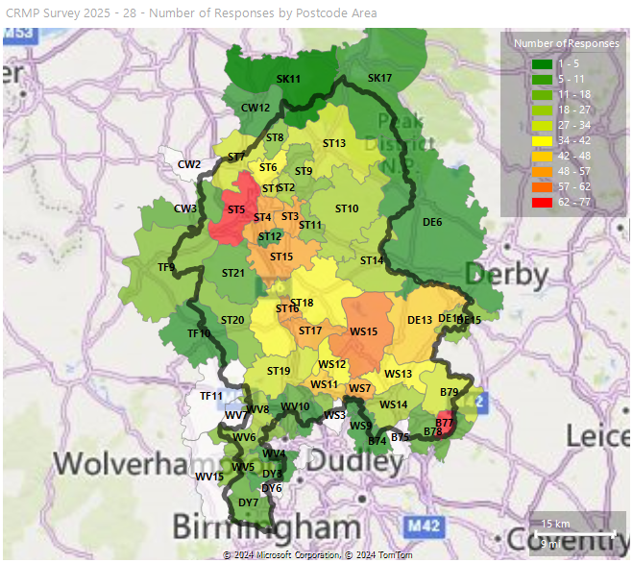
Completed Surveys by Postcode Area
Survey respondents provided their home postcode, which have been grouped by postcode area to help understand the levels of engagement to the survey across Staffordshire and Stoke-on-Trent.
This map illustrates the distribution of response rates across different post code areas. Areas in red indicate higher engagement, while those in green reflect lower response levels.
Newcastle-under-Lyme (ST5) and the east part of Tamworth (B77) had the highest concentration of responses.
Notes:
1292 surveys used for analysis. Surveys not used in postcode analysis are : surveys where no postcode given, postcodes with errors where it can’t be identified

Slide 7
Community Representation
The following analysis is to help understand how well the survey reflects the diverse backgrounds of our Communities.
It looks at representation across age, disability, sex, gender identity and ethnicity.
Representation is shown by comparing demographic data recorded in the survey to the corresponding Census 2021 populations.
The analysis aims to:
  Identify well-represented groups for balanced insights
  Recognise any over or underrepresented groups to guide future outreach

Slide 8
Community Representation - Age
Survey results show strong representation from the following age groups:
25 to 44
45 to 64
65 to 74
75 plus
These age groups align with or exceeds population proportions, ensuring diverse perspectives are captured.
The 16 to 24 age group had lower participation than other age groups. However, in the public perception focus groups, ages 18 to 24 were 15% of participants, ensuring the younger age group were better represented and their views taken into account.
Notes:
Staffordshire and Stoke-on-Trent population by age category from 2021 census – blue hashed bars indicate % population by age category
Orange bars indicate the completed surveys % by age category
The closer the orange bar is to the blue hashed bar, the better the representation

Slide 9
Community Representation - Disability
Survey results indicate that individuals with disabilities are well represented.
Representation closely aligns with the population proportions, which gives confidence that the perspectives of people with disabilities are accurately reflected.
The level of engagement provides a good base for continued outreach for people with disabilities.
Notes:
Staffordshire and Stoke-on-Trent population by disability category from 2021 census (Disabled under the Equality Act) – blue hashed bars indicate % population by disability category
Orange bars indicate the completed surveys % by disability category
The closer the orange bar is to the blue hashed bar, the better the representation

Slide 10
Community Representation – Gender Identity and Sex
The charts compare the percentage population for Staffordshire and Stoke-on-Trent against the percentage of completed surveys respondents by gender identity and sex
The closer the bars match the closer the representation.
All groups are well represented in the survey. Transgender and non-binary have a slightly higher representation, although with only 3 and 2 completed surveys respectively.
Notes:
Staffordshire and Stoke-on-Trent population by sex and gender identity categories from 2021– blue hashed bars indicate % population by disability category
Orange bars indicate the completed surveys % by disability category
The closer the orange bar is to the blue hashed bar, the better the representation
*Please note that in September 2024 the Office for National Statistics (ONS) now classify Gender Identity statistics form the 2021 census no longer as Accredited Official Statistics but now as Official Statistics in Development. This means that there may be some accuracy issues relating to the gender identity population data.

Slide 11
Representation of the Community - Ethnicity
Other ethnic group
The survey shows a varied representation across different ethnicities. Well-represented groups included Black: African, White: Irish, and Chinese
Some ethnicities have quite small populations, such as Gypsy or Irish Traveller and with 2 surveys successfully represent the size of the community.
However, 3 of our Asian communities, Other Asian, Pakistani, and Indian, have larger populations, but have a much lower representation in terms of survey respondents.
Through the Public Perception Focus Groups, the service requested more participants should be from Other Asian, Pakistani, and Indian ethnic backgrounds. This ensured that our larger ethnic minority groups were better represented overall.
White
Mixed or Multiple ethnic groups
Black, Black British, Black Welsh,
Caribbean or African
Asian, Asian British or Asian Welsh
White

Slide 12
Awareness of Services and Services Used

Slide 13
Awareness of Services and Services Used
People’s engagement and knowledge of the services provided are high despite not having used or accessed them. This is shown in by respondents awareness of the 999 emergency response (99% awareness and 11% use) and Safe and Well\Home Fire Safety Visits (84% awareness and 17% use).
In contrast, awareness of services in the public perception focus groups was quite low. This indicates that people completing the survey, including many being an employee, ex-employee, or relative of an employee, may already have an awareness or interest before engaging in the consultation.
Home From Hospital\Falls Response and Fire Setter Intervention, have both low awareness and usage, but these are services we deliver on behalf of the NHS/Social Care on a referrals basis.

Slide 14
Awareness of Services and Services Used
While there were some negative responses, a large proportion of comments provided around the services we provide were positive. A large number centred around a general high regard for the Service:
“First class professional service”
“Great experiences from all the services used.”
Complimentary on the Service’s response to incidents and Safe and Well/Home Fire Safety visits:
“I was in a car accident and the fire service had to cut me out of my car. They did an excellent job and I want to thank them for being very kind and considerate at a very difficult time.”
“I could not have had a better response, the fire officer that came completely reviewed my house checking all the alarms and updating me on all.”
And supportive of the Service’s station open days and events:
“Open days are a great event for engaging with the community, and gives the community a great insight into their local fire station and the services provided.”

Slide 15
Staffordshire Fire and Rescue Service should do more to…
The results highlight a strong desire to expand core safety services like fire safety inspections in buildings and prevention work. The high priority placed on building inspections may reflect heightened awareness of fire safety issues following the Grenfell fire tragedy. The awareness was also echoed in the Public Perception focus groups.
Lower emphasis was given to address the impact of climate change, which may suggest our Communities feel the Service is already doing enough to address climate change or sees it as a less immediate priority.

Slide 16
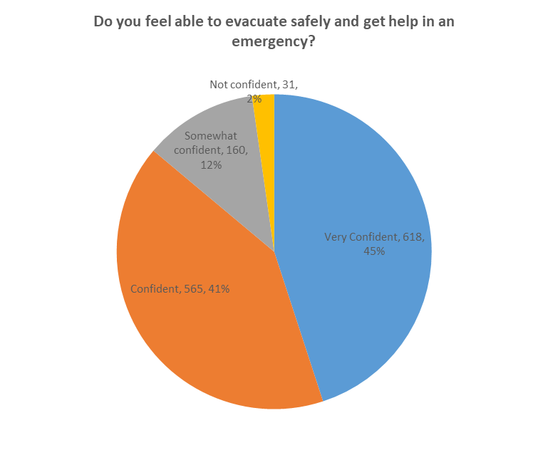
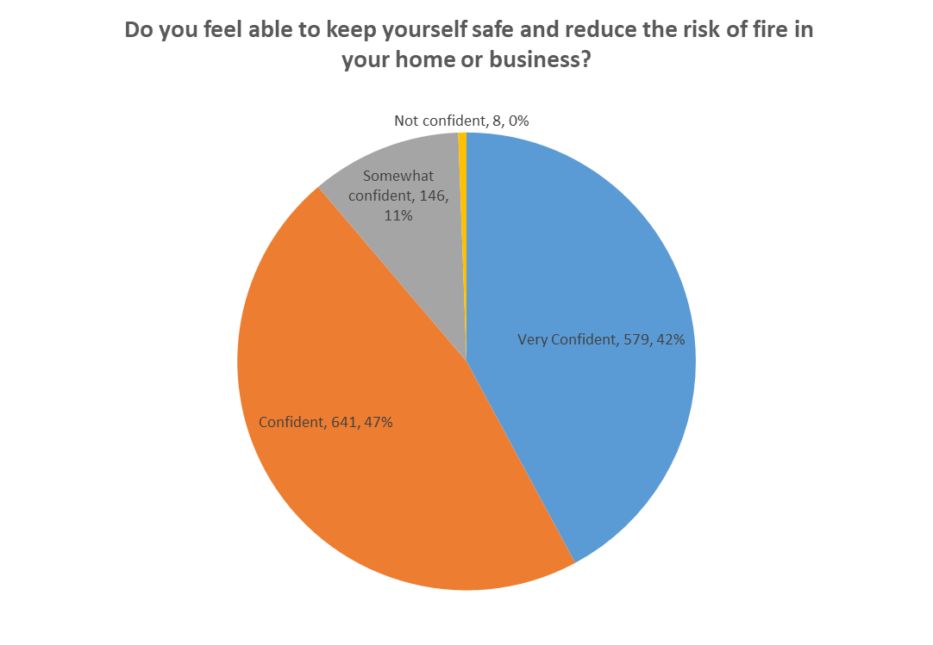
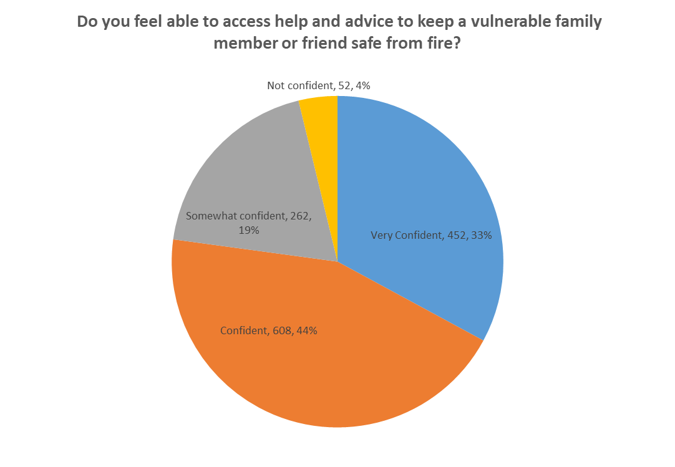
Confidence
Confidence average 3.3
Confidence average 3.3
Confidence average 3.1
The confidence average score is calculated by giving each confidence level a score of 1 to 4
Not confident = 1, Somewhat Confident = 2, Confident = 3, Very Confident = 4

Slide 17
Confidence
The majority of survey respondents were either confident or very confident overall. However, confidence levels were slightly lower when it came to helping a family member or friend, suggesting a potential need to improve communication on how individuals can assist others in accessing support.
People who didn’t feel confident expressed that they weren’t sure how to keep safe or how they would assist other to keep safe:
“I’m not sure what I’d do in the event of a fire, I live in a 3 storey house”
“I have an elderly relative who has dementia who lives around the corner from me and, although I have done as much as I can to help with fire prevention, I feel it would be good to seek professional advice too but I don’t know how to access it.”
And they also had concerns for their own and other’s vulnerabilities:
“I am hard of hearing and worry I may not hear my smoke alarms”
“I can't walk. I'm supposed to be in a wheelchair but it's too big for all of the doors in my flat.”
“I am unsure how to keep anyone safe as I have mobility issues.”

Slide 18
Service Initiatives
Three firefighters crewing On-call fire engines
Survey Question
The Service strives to crew our on-call appliances with 4 or more firefighters.
This is not always achievable all of the time so for those occasions that we have 3 suitably trained firefighters available, the Service can mobilise them to emergencies to make lifesaving interventions more rapidly whilst the next nearest fully crewed appliance is on the way.
This approach is currently under trial and has seen positive results including a faster attendance by over 9 minutes on some occasions.
Do you agree that the Service should continue with this approach?

Slide 19
Service Initiatives
Three firefighters crewing On-call fire engines
The initiative received strong support in the survey, with 80% in favour and 20% against, while the public perception focus groups showed a slight majority in support.
Survey feedback was specifically sought from respondents who did not support the initiative. The main themes centred around concerns about safety, opposition to potential reductions, and doubts about the effectiveness of responding with three.
  “3 riders is putting an undue amount of pressure on fire crews in an environment that is already high pressure and stress where room for error is so small otherwise our safety and the publics safety could be compromised ”
  “I pay council tax for a fully funded service. I can't see how going out with a crew of 3 can be effective service for the community or be safe for the firefighters themselves”
The Public Perception focus highlighted a mix of responses, similarly to the survey responses concerned around safety but the majority of participants did see the benefit of faster response time to provide earlier interventions. Other responses were themed around support depending on the nature of the incident, a strong preference for hearing directly from firefighters, and the fears of normalising cost cutting.

Slide 20
Service Initiatives
Home From Hospital and Falls Response
Survey Question
Our Home from Hospital initiative sees our Fire and Health Partnership Technicians assisting with hospital discharges by collecting patients from the Royal Stoke hospital and transporting them to their homes across Staffordshire, making sure they are settled in safely. This initiative brings us into contact with vulnerable people so we can also help keep them safe from fire.
The Service’s Falls Response team provides support to people suffering ‘non-injury’ falls at home, assisting patients in getting up and ensuring that they receive the necessary care to maintain their well-being and reduce the likelihood of complications.
Both projects have proved highly successful, with our teams assisting many individuals resulting in significant benefits for both the individuals and the NHS. So as not to affect the availability of our emergency fire crews we have recruited a dedicated team of fire and health technicians to provide these services.
Do you agree that Staffordshire Fire and Rescue Service should be delivering these services?

Slide 21
Service Initiatives
Home From Hospital and Falls Response
The initiative received strong support in the survey, with 80% in favour, 19% against, and 1% unsure*
Survey feedback was specifically sought from respondents who did not support the initiative. Respondents who did not support the initiative felt that the service should be done by the NHS or other providers and did not believe it to be the duty of the Fire and Rescue Service.
  “This is a job for the NHS”
  “The NHS should be dealing with these things in case there are injuries. The fire service is under as much stress as the NHS”
Other respondents believed that the service had been funded by the Fire and Rescue Service and did not want firefighters to be involved in providing this work. This highlights the need for further communication to provide more details about the initiative, addressing concerns around funding and how the teams are staffed.
  “On duty firefighters, I believe, should not be doing this.”
  “This does not seem the most effective use of Fire Service funding to me. The NHS has enormous underused employee resources to deliver that.”
Notes:
*Due to an error in the report design, respondents were able to answer yes and no. However, the accompanying comments reflected many respondent’s uncertainty.

Slide 22
Service Initiatives
Intelligent Monitoring of Fire Engine Availability
Survey Question
Whilst our ambition remains that our fire appliances are available 100% of the time, we are proposing to more intelligently monitor when a fire station’s performance falls below expected levels so we can proactively help them to improve their availability.
Do you agree that the Service should adopt this approach?

Slide 23
Service Initiatives
Intelligent Monitoring of Fire Engine Availability
The initiative received strong support in the survey, with 88% in favour, and 12% against.
Survey feedback was specifically sought from respondents who did not support the initiative. The main reason respondents did not support the initiative was because they struggled to understand the question or needed more information to be a able to answer. Further communications would be beneficial to increase the understanding of the initiative into the future.
  “Not enough detail what does this mean exactly? without the detail it is a no”
  “The question is very difficult to answer for a layperson.”
The other main theme of respondents who did not support the imitative, was in opposition to proposing a reduction in fire cover and the belief that the Service should aim for 100% availability.
  “Fire engines should always be available”
  “Everyone deserves the same quality of service regardless of whether they live somewhere that would be deemed less likely to need the service”

